Slide 1
Study cases report
姓名: 劉哲宇

Slide 2
General Design Process
Consideration
Ideal
Functionality
*Timing
Reliability
Testability
*Area
*Power
Design
Verification
Implantation
Verification
Implantation
Repeat Veri. & Imp.
Verified Chip Layout

Slide 3
RTL
Verilog or VHDL
RTL functional simulation
Test Bench
Architectural Refinement
RTL
Verilog or VHDL
General Setup
MCMM Setup
FEC
Reference Design
Formal verification
Synthesis and optimization
Floorplan Definition
STA
(PrimeTime)
Netlist
FEC
Reference Design
Placement
Scan-chain stitching
Clock Tree Synthesis
Timing Constraint
STA
(PrimeTime)
Netlist
FEC
Reference Design
Route
Physical Design
DFM
STA
(PrimeTime)
Reference Design
Netlist
FEC

Slide 4
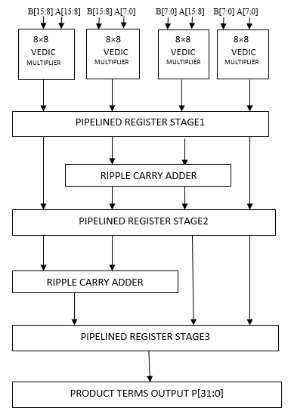
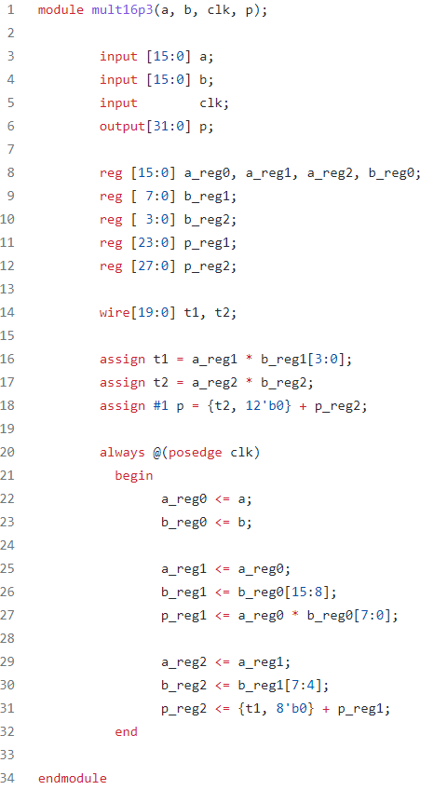
16-bit 3-stage pipelined multiplier
RTL code

Slide 5
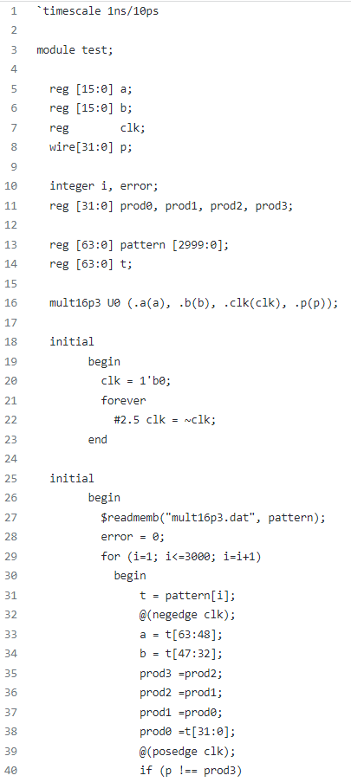
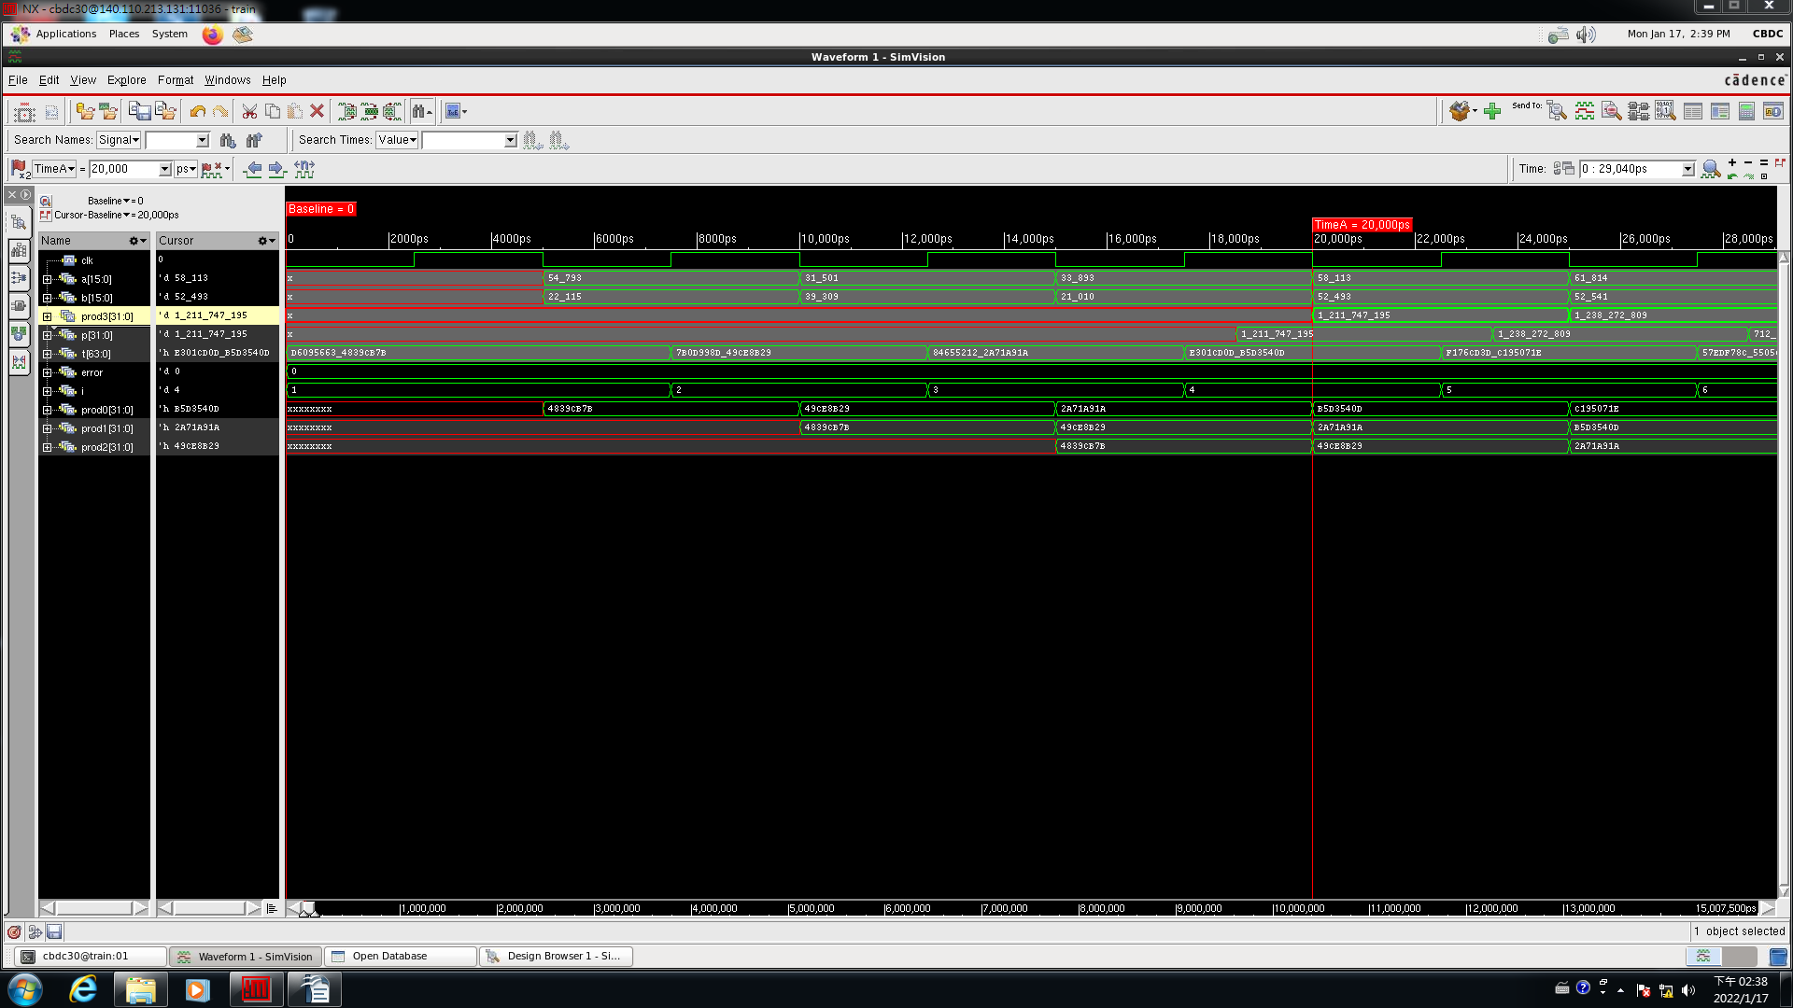
RTL simulation pattern.v
C SimVision

Slide 6
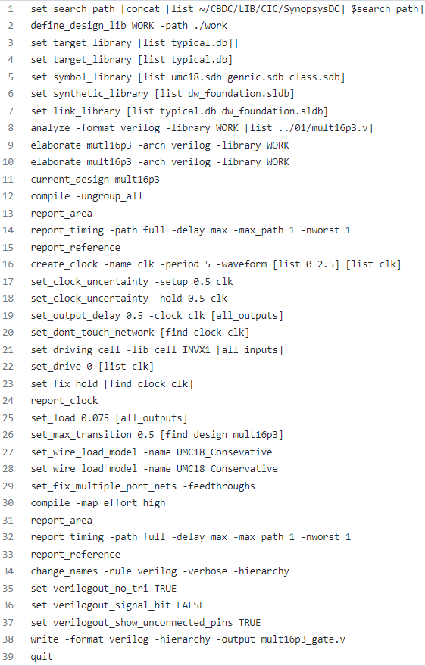
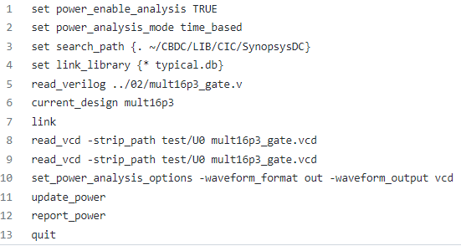
Design Compiler
Gate-level Design Analysis
PrimeTime

Slide 7
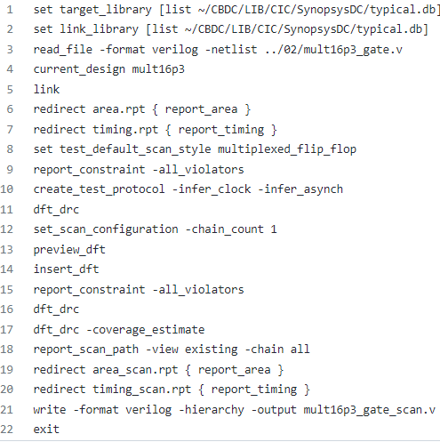
DFT

